Slide 1


Microprocessors and Assembly Language Spring 2020
Hamed Farbeh
farbeh@aut.ac.ir
Department of Computer Engineering
Amirkabir University of Technology
Lecture 5

Slide 2
Copyright Notice
Parts (text & figures) of this lecture are adopted from:
Cortex™-M3 Revision r2p1 Technical Reference Manual
ARMv7-M Architecture Reference Manual
Atmel | SMART ARM-based MCU DATASHEET, SAM3X / SAM3A Series, Atmel-11057C-ATARM-SAM3X-SAM3A-Datasheet_23-Mar-15
Microprocessors and Assembly Language, Spring 2020, AUT, Tehran, Iran

Slide 3
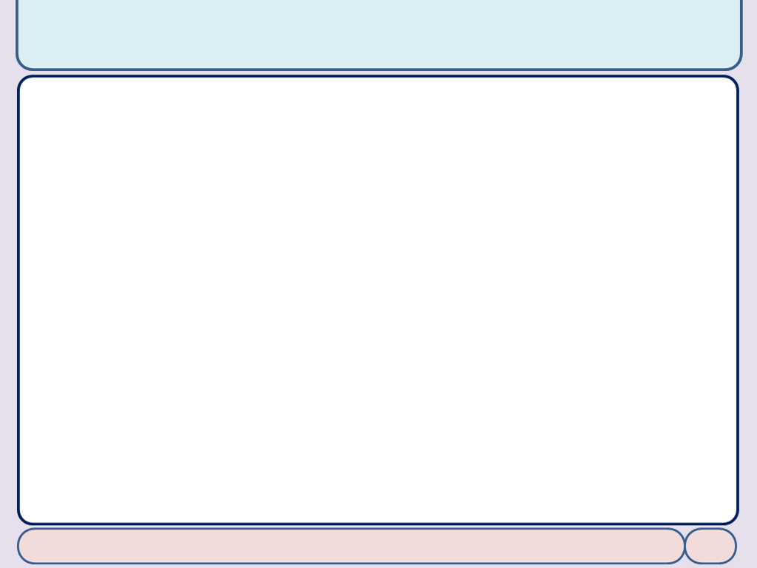
Interrupts (2)
Microprocessors and Assembly Language, Spring 2020, AUT, Tehran, Iran

Slide 4
Interrupts Handling
Functions to access the NVIC
void NVIC_EnableIRQ (IRQn_Type IRQn)
enables the specified device specific interrupt IRQ
uint32_t NVIC_GetEnableIRQ (IRQn_Type IRQn)
void NVIC_DisableIRQ (IRQn_Type IRQn)
void NVIC_SetPendingIRQ (IRQn_Type IRQn)
uint32_t NVIC_GetPendingIRQ (IRQn_Type IRQn)
void NVIC_ClearPendingIRQ (IRQn_Type IRQn)
uint32_t NVIC_GetActive (IRQn_Type IRQn)
https://www.keil.com/pack/doc/cmsis/Core/html/group__NVIC__gr.html#details
Microprocessors and Assembly Language, Spring 2020, AUT, Tehran, Iran

Slide 5
Interrupts Handling
Functions to access the NVIC
void NVIC_SetPriority (IRQn_Type IRQn, uint32_t priority)
The number of priority levels is configurable and depends on the implementation of the chip designer. To determine the number of bits implemented for interrupt priority-level registers, write 0xFF to one of the priority-level register, then read back the value. For example, if the minimum number of 3 bits have been implemented, the read-back value is 0xE0
Writes to unimplemented bits are ignored
For Cortex-M3, Cortex-M4, and Cortex-M7
Dynamic switching of interrupt priority levels is supported
Supports 0 to 255 priority levels
Priority-level registers have a maximum width of 8 bits and a minimum of 3 bits
https://www.keil.com/pack/doc/cmsis/Core/html/group__NVIC__gr.html#details
Microprocessors and Assembly Language, Spring 2020, AUT, Tehran, Iran

Slide 6
Interrupts Handling
Functions to access the NVIC
uint32_t NVIC_GetPriority (IRQn_Type IRQn)
uint32_t NVIC_GetVector (IRQn_Type IRQn)
This function allows to read the address of an interrupt handler function
void NVIC_SetVector (IRQn_Type IRQn, uint32_t vector)
This function allows to change the address of an interrupt handler function
void NVIC_SystemReset (void)
This function requests a system reset by setting the SYSRESETREQ flag
https://www.keil.com/pack/doc/cmsis/Core/html/group__NVIC__gr.html#details
Microprocessors and Assembly Language, Spring 2020, AUT, Tehran, Iran

Slide 7
Interrupts Handling
The symbol __Vectors is the address of the vector table in the startup code
Register SCB->VTOR holds the start address of the vector table
SCB: System Control Block, some of its registers:
ICSR: Interrupt Control and State Register
VTOR: Vector Table Offset Register
AIRCR: Application Interrupt and Reset Control Register
SCR: System Control Register
https://www.keil.com/pack/doc/cmsis/Core/html/group__NVIC__gr.html#details
Microprocessors and Assembly Language, Spring 2020, AUT, Tehran, Iran

Slide 8
Vector Table
At the beginning of the vector table, the initial stack value and the exception vectors of the processor are defined
__Vectors DCD __initial_sp ; Top of Stack initialization
DCD Reset_Handler ; Reset Handler
DCD NMI_Handler ; NMI Handler
DCD HardFault_Handler ; Hard Fault Handler
DCD MemManage_Handler ; MPU Fault Handler
DCD BusFault_Handler ; Bus Fault Handler
DCD UsageFault_Handler ; Usage Fault Handler
DCD SecureFault_Handler ; Secure Fault Handler
DCD 0 ; Reserved
DCD 0 ; Reserved
DCD 0 ; Reserved
DCD SVC_Handler ; SVCall Handler
DCD DebugMon_Handler ; Debug Monitor Handler
DCD 0 ; Reserved
DCD PendSV_Handler ; PendSV Handler
DCD SysTick_Handler ; SysTick Handler
https://www.keil.com/pack/doc/cmsis/Core/html/group__NVIC__gr.html#details
Microprocessors and Assembly Language, Spring 2020, AUT, Tehran, Iran

Slide 9
Vector Table
Device Specific Vectors
Following the processor exception vectors, the vector table contains also the device specific interrupt vectors
__Vectors DCD __initial_sp ; Top of Stack initialization
DCD Reset_Handler ; Reset Handler
…
DCD SysTick_Handler ; SysTick Handler
; device specific interrupts
DCD WWDG_IRQHandler ; Window Watchdog
DCD PVD_IRQHandler ; PVD through EXTI Line detect
DCD TAMPER_IRQHandler ; Tamper
All device specific interrupts should have a default interrupt handler function that can be overwritten in user code
Remapping interrupt vectors by updating VTOR register
An example: https://www.keil.com/pack/doc/cmsis/Core/html/using_VTOR_pg.html
https://www.keil.com/pack/doc/cmsis/Core/html/group__NVIC__gr.html#details
Microprocessors and Assembly Language, Spring 2020, AUT, Tehran, Iran

Slide 10
interrupt handler function
Default_Handler PROC
EXPORT WWDG_IRQHandler [WEAK]
EXPORT PVD_IRQHandler [WEAK]
EXPORT TAMPER_IRQHandler [WEAK]
:
:
WWDG_IRQHandler
PVD_IRQHandler
TAMPER_IRQHandler
:
:
B .
ENDP
The user application may simply define an interrupt handler function by using the handler name
void WWDG_IRQHandler(void)
{
...
}
https://www.keil.com/pack/doc/cmsis/Core/html/group__NVIC__gr.html#details
Microprocessors and Assembly Language, Spring 2020, AUT, Tehran, Iran

Slide 11
interrupt handler function
#include "LPC17xx.h"
uint32_t active; /* Variable to store interrupt active state */
void TIMER0_IRQHandler(void) { /* Timer 0 interrupt handler */
if (LPC_TIM0->IR & (1 << 0)) { /* Check if interrupt for match channel 0 occured */
LPC_TIM0->IR |= (1 << 0); /* Acknowledge interrupt for match channel 0 occured */
}
active = NVIC_GetActive(TIMER0_IRQn); /* Get interrupt active state of timer 0 */
}
int main (void) {
/* Set match channel register MR0 to 1 millisecond */
LPC_TIM0->MR0 = (((SystemCoreClock / 1000) / 4) - 1); /* 1 ms? */
LPC_TIM0->MCR = (3 << 0); /* Enable interrupt and reset for match channel MR0 */
NVIC_EnableIRQ(TIMER0_IRQn); /* Enable NVIC interrupt for timer 0 */
LPC_TIM0->TCR = (1 << 0); /* Enable timer 0 */
while(1);
}
https://www.keil.com/pack/doc/cmsis/Core/html/group__NVIC__gr.html#details
Microprocessors and Assembly Language, Spring 2020, AUT, Tehran, Iran

Slide 12
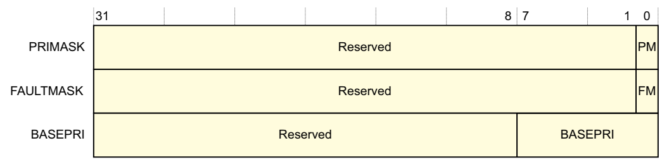
Masking Exception
PRIMASK: Exception mask register (CPU core)
Register to mask out configurable exceptions
A 1-bit register
Setting PRIMASK to 1 raises the execution priority to 0
CMSIS-CORE API
void __enable_irq() // clears PM flag
void __disable_irq() // sets PM flag
uint32_t __get_PRIMASK() // returns value of PRIMASK
void __set_PRIMASK(uint32_t x) // sets PRIMASK to x
BASEPRI: Mask exception from a defined level
An 8-bit register
BASEPRI changes the priority level required for exception preemption
A value of zero disables masking by BASEPRI
FAULTMASK
A 1-bit register
Raises the execution priority to -1 (the priority of HardFault)
Returning from any exception except NMI clears FAULTMASK to 0
REF: ARMv7-M Architecture Reference Manual
Microprocessors and Assembly Language, Spring 2020, AUT, Tehran, Iran

Slide 13
CMSIS
CMSIS: Cortex Microcontroller Software Interface Standard
Is a vendor-independent hardware abstraction layer for microcontrollers that are based on Arm® Cortex® processors
Defines generic tool interfaces and enables consistent device support
Provides simple software interfaces to the processor and the peripherals
Simplifies software re-use
Reduces the learning curve for microcontroller developers,
Reduces the time to market for new devices
Has been created to help the industry in standardization
Enables consistent software layers and device support across a wide range of development tools and microcontrollers
The CMSIS recommends the following conventions for identifiers:
CAPITAL names to identify Core Registers, Peripheral Registers, and CPU Instructions.
CamelCase names to identify function names and interrupt functions.
Namespace_ prefixes avoid clashes with user identifiers and provide functional groups (i.e. for peripherals, RTOS, or DSP Library)
http://www.keil.com/pack/doc/CMSIS/General/html/index.html
Microprocessors and Assembly Language, Spring 2020, AUT, Tehran, Iran

Slide 14
Maximum Interrupt Rate
We can only handle so many interrupts per second
F_{Max_Int}: maximum interrupt frequency
F_{CPU}: CPU clock frequency
C_{ISR}: Number of cycles ISR takes to execute
C_{Overhead:} Number of cycles of overhead for saving state, vectoring, restoring state, etc.
F_{Max_Int} = F_{CPU}/(C_{ISR+} C_{Overhead})
Note that model applies only when there is one interrupt in the system
When processor is responding to interrupts, it isn’t executing our other code
U_{Int}: Utilization (fraction of processor time) consumed by interrupt processing
U_{Int} = 100%*F_{Int}* (C_{ISR}+C_{Overhead})/ F_{CPU}
CPU looks like it’s running the other code with CPU clock speed of (1-U_{Int})*F_{CPU}
Microprocessors and Assembly Language, Spring 2020, AUT, Tehran, Iran

Slide 15
Sharing Data Safely between ISRs and other Threads
Volatile data: can be updated outside of the program’s immediate control
In computer programming, particularly in the C, C++, C#, and Java programming languages, the volatile keyword indicates that a value may change between different accesses, even if it does not appear to be modified. This keyword prevents an optimizing compiler from optimizing away subsequent reads or writes and thus incorrectly reusing a stale value or omitting writes. Volatile values primarily arise in hardware access (memory-mapped I/O), where reading from or writing to memory is used to communicate with peripheral devices, and in threading, where a different thread may have modified a value. [Wikipedia]
Non-atomic shared data: can be interrupted partway through read or write, is vulnerable to race conditions
Microprocessors and Assembly Language, Spring 2020, AUT, Tehran, Iran

Slide 16
Non-Atomic Shared Data
Want to keep track of current time and date
Use 1 Hz interrupt from timer
System
TimerVal structure tracks time and days since some reference event
TimerVal’s fields are updated by periodic 1 Hz timer ISR
void GetDateTime(DateTimeType * DT){
DT->day = TimerVal.day;
DT->hour = TimerVal.hour;
DT->minute = TimerVal.minute;
DT->second = TimerVal.second;
}
void DateTimeISR(void){
TimerVal.second++;
if (TimerVal.second > 59){
TimerVal.second = 0;
TimerVal.minute++;
if (TimerVal.minute > 59) {
TimerVal.minute = 0;
TimerVal.hour++;
if (TimerVal.hour > 23) {
TimerVal.hour = 0;
TimerVal.day++;
… etc.
}
Microprocessors and Assembly Language, Spring 2020, AUT, Tehran, Iran

Slide 17
Non-Atomic Shared Data
Problem
An interrupt at the wrong time will lead to half-updated data in DT
Failure Case
TimerVal is {10, 23, 59, 59} (10th day, 23:59:59)
Task code calls GetDateTime(), which starts copying the TimerVal fields to DT: day = 10, hour = 23
A timer interrupt occurs, which updates TimerVal to {11, 0, 0, 0}
GetDateTime() resumes executing, copying the remaining TimerVal fields to DT: minute = 0, second = 0
DT now has a time stamp of {10, 23, 0, 0}
The system thinks time just jumped backwards one hour!
Fundamental problem – “race condition”
Preemption enables ISR to interrupt other code and possibly overwrite data
Must ensure atomic (indivisible) access to the object
Microprocessors and Assembly Language, Spring 2020, AUT, Tehran, Iran

Slide 18
Examining the Problem More Closely
Must protect any data object which both
requires multiple instructions to read or write (non-atomic access),
and
is potentially written by an ISR
void GetDateTime(DateTimeType * DT){
uint32_t m;
m = __get_PRIMASK();
__disable_irq();
DT->day = TimerVal.day;
DT->hour = TimerVal.hour;
DT->minute = TimerVal.minute;
DT->second = TimerVal.second;
__set_PRIMASK(m);
}
Microprocessors and Assembly Language, Spring 2020, AUT, Tehran, Iran

Slide 19
The End!
Microprocessors and Assembly Language, Spring 2020, AUT, Tehran, Iran

